Slide 1
STUDENT NAME: Jemima.R
REG NO: 962821104039
DEPARTMENT: Computer science and
ENGINEERING
FINAL PROJECT

Slide 2
PROJECT TITLE
AI-based Poetry Generator

Slide 3
AGENDA
Introduction
Problem Statement
Project Overview
Solution and Value Proposition
The Wow in Our Solution
Modelling
Results

Slide 4
PROBLEM STATEMENT:
Many people struggle with expressing themselves through poetry due to the complexities of language and the creative process involved. Moreover, not everyone has the time or inspiration to craft meaningful poems. There is a need for a tool that can assist individuals in generating poetic verses on various topics without the need for extensive poetic knowledge or creativity.

Slide 5
PROJECT OVERVIEW:
The project aims to develop a generative AI network capable of creating poetry. The AI will take input prompts such as theme, mood, and desired length, and generate unique poetic verses accordingly. Users can use these generated poems for personal enjoyment, creative writing projects, or as writing prompts.

Slide 6
WHO ARE THE END USERS?
Educators: Teachers who want to introduce their students to poetry writing or use generated poems as teaching aids.
Poetry Enthusiasts: Individuals who enjoy reading and writing poetry but may sometimes struggle with inspiration or writer's block.
Content Creators: Bloggers, social media influencers, or marketers who need engaging content for their platforms.

Slide 7
SOLUTION AND ITS VALUE PROPOSITION
Our solution is an AI-powered poetry generator that offers:
Inspiration: Provides users with poetic verses on various themes, sparking creativity and imagination.
Customization: Allows users to specify themes, moods, and length preferences for generated poems, catering to their specific needs.
Quality: Generates poems that adhere to poetic conventions and are coherent and meaningful.
Versatility: Suitable for a wide range of applications including personal use, educational purposes, or content creation.

Slide 8
The Wow in Your Solution:
The wow factor in our solution lies in the AI's ability to produce emotionally resonant and aesthetically pleasing poetry that captures the essence of the input prompts. Additionally, the interactive nature of the tool, allowing users to input their preferences and see real-time poem suggestions, will enhance user engagement and satisfaction.

Slide 9
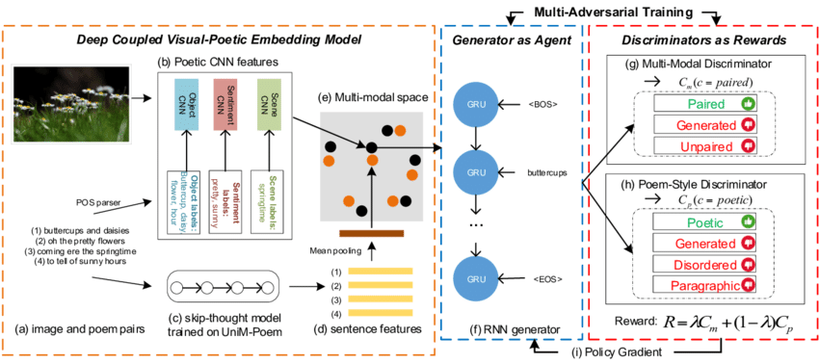
MODELLING

Slide 10
RESULTS:
This is a simplified demonstration. The actual implementation would involve training an RNN-LSTM model on a large corpus of poetry and fine-tuning it for poem generation. Additionally, user inputs would need to be integrated into the generation process for customization. This code is intended to provide a basic framework for the project.
DEMO LINK:
https://github.com/Jemima0403/TNSDC-Generative-AI

